Slide 1

Multimodal Learning in Healthcare
Che Liu
27 Feb 2025

Slide 2
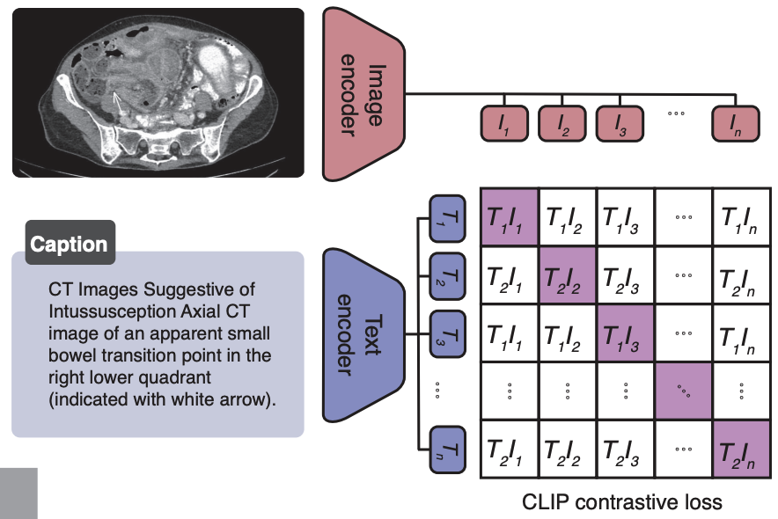
Can Medical Vision-Language Pre-training Succeed with Purely Synthetic Data?
OpenAI-CLIP: 400M
BiomedCLIP: 15M
BIOMEDICA: 24M
CLIP success on large-scale data

Slide 3
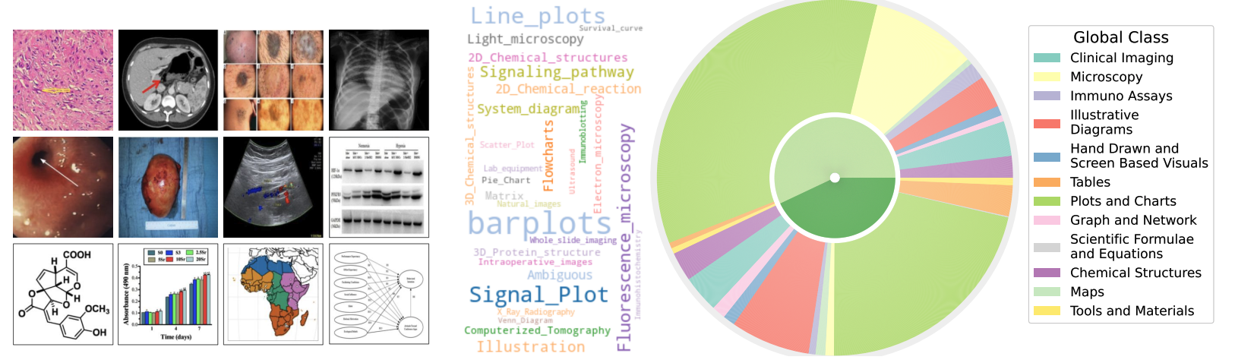
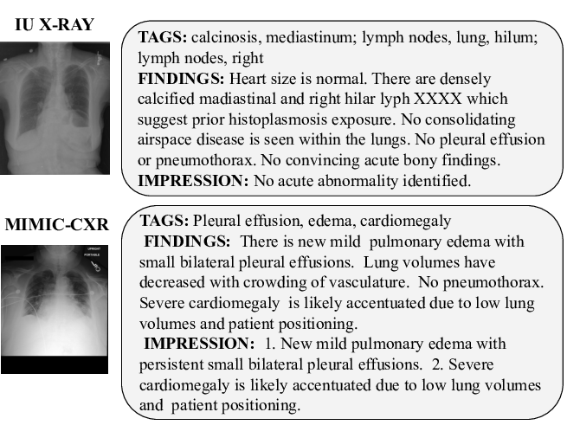
Where can we get data for Medical VLP?
From Internet
large scale, but noisy
From Hospital
High quality, but costly

Slide 4
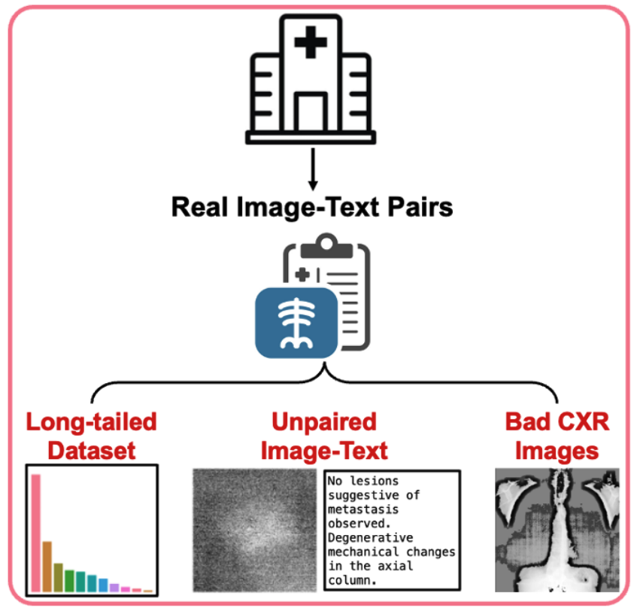
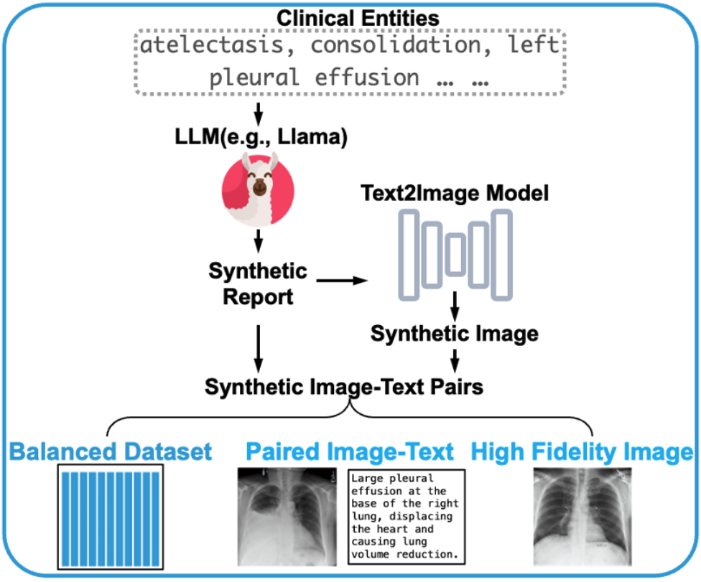
uncontrollable data source in the real world
Infinite data from Gen Model

Slide 5
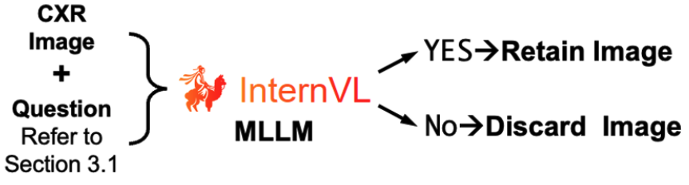
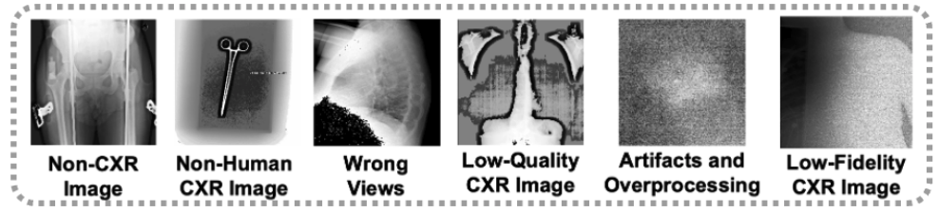
Hospital data is not good enough
Please verify if the given image is a human chest X-ray scan. If it is a chest X-ray, return ‘YES’. Otherwise, return ‘NO’.
Bad Images with ‘No’

Slide 6

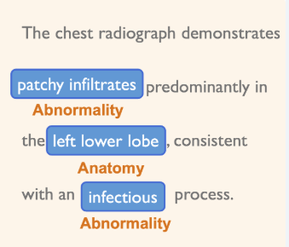
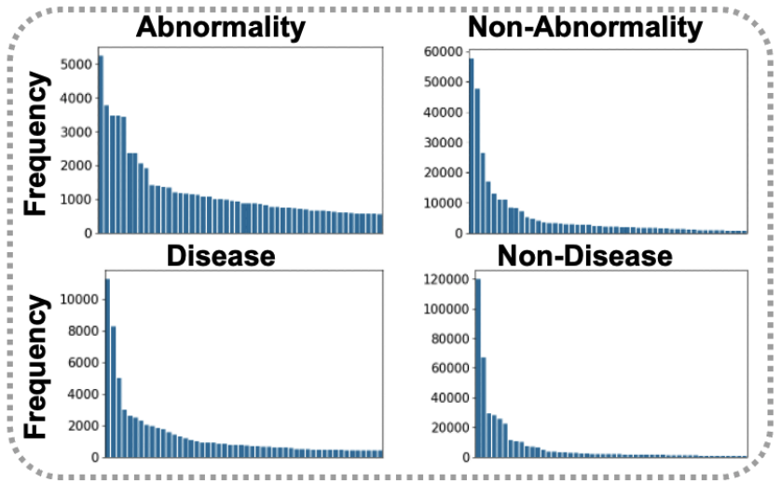
Real data is long-tailed
Medical Report
Long-tailed Distribution

Slide 7
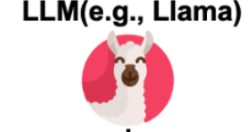

Generating Medical Reports
Entities Bank
Sampling equal number entities for each instance
Synthetic Medical Report

Slide 8
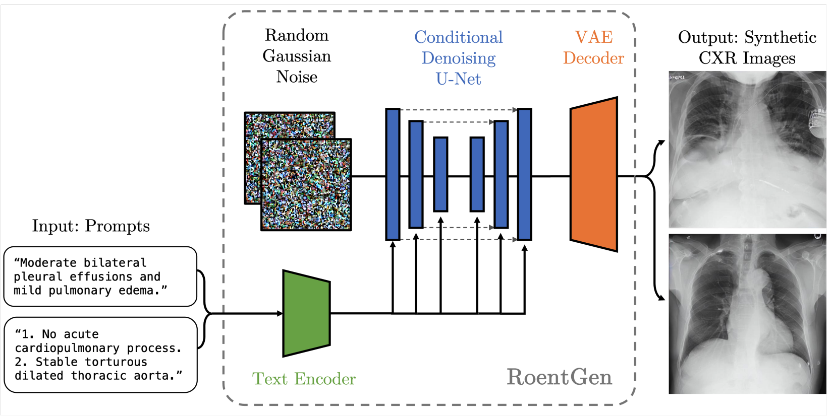
Generating CXR Images with synthetic medical reports
We use RoentGen as Gen model.

Slide 9
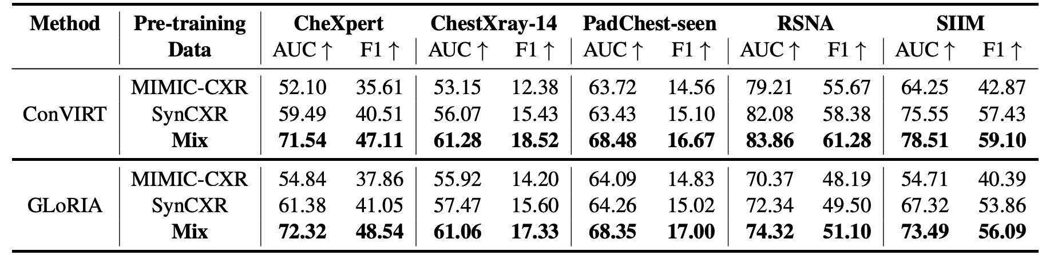
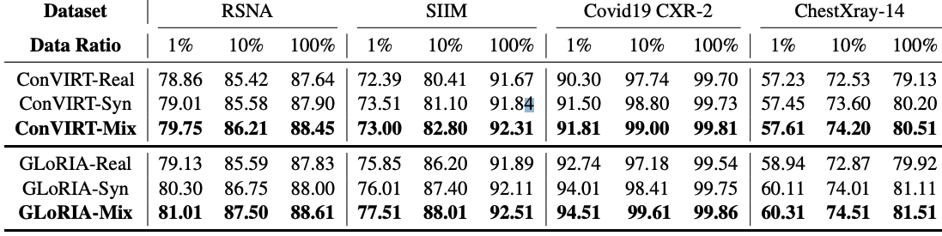
We build ‘SynCXR’, it has 200k synthetic image-text pairs.
VLP success on Synthetic data!
Zero-shot Classification
Finetune Classification

Slide 10
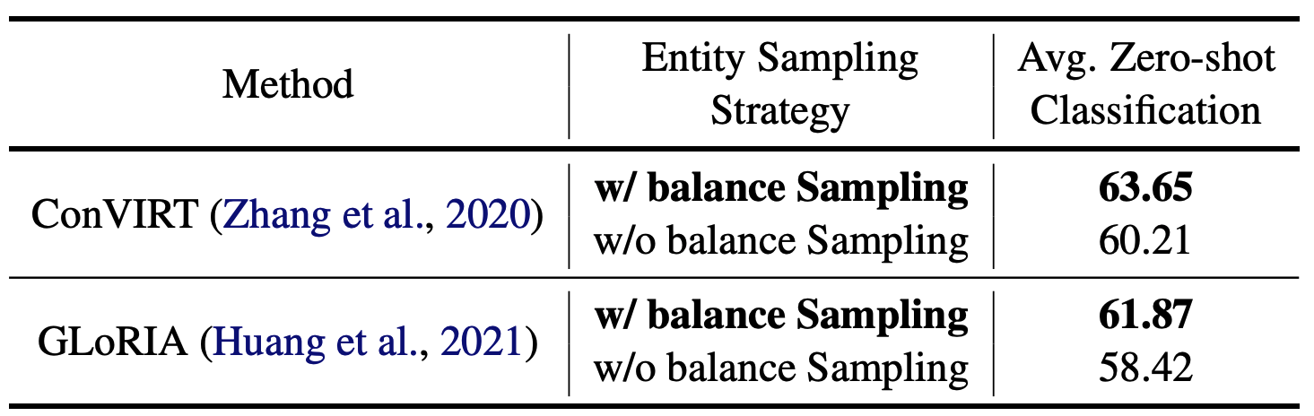
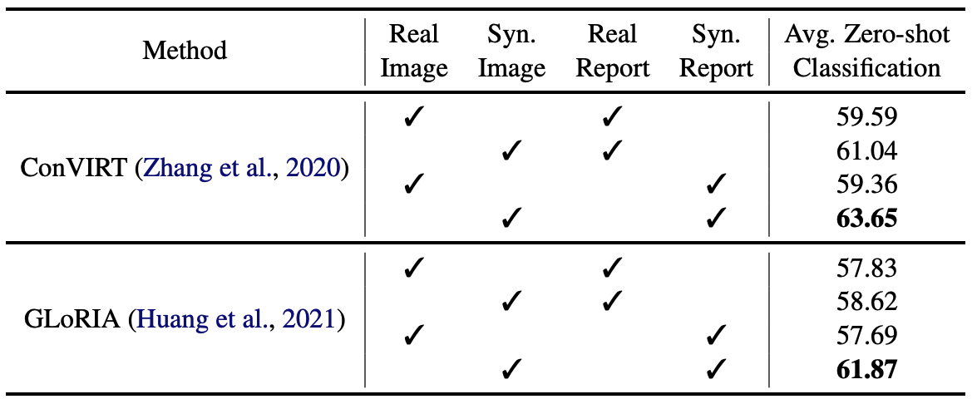
Balance dataset is important.
Synthetic Image is more beneficial than reports.

Slide 11
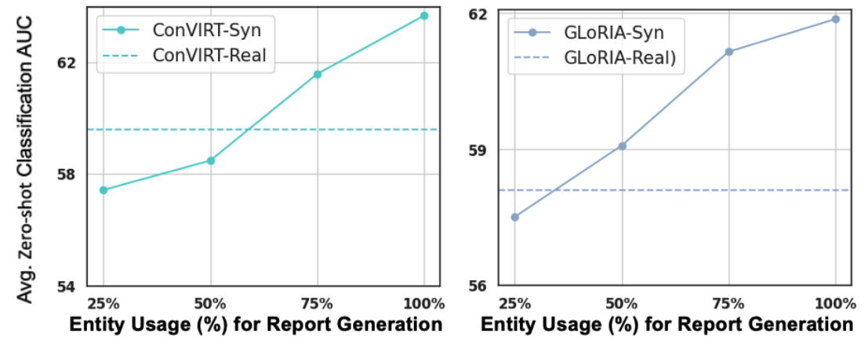
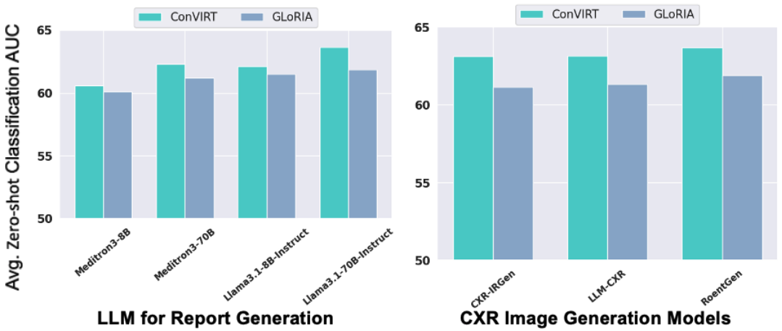
Diverse dataset gives better results
Always selecting powerful Gen Model

Slide 12
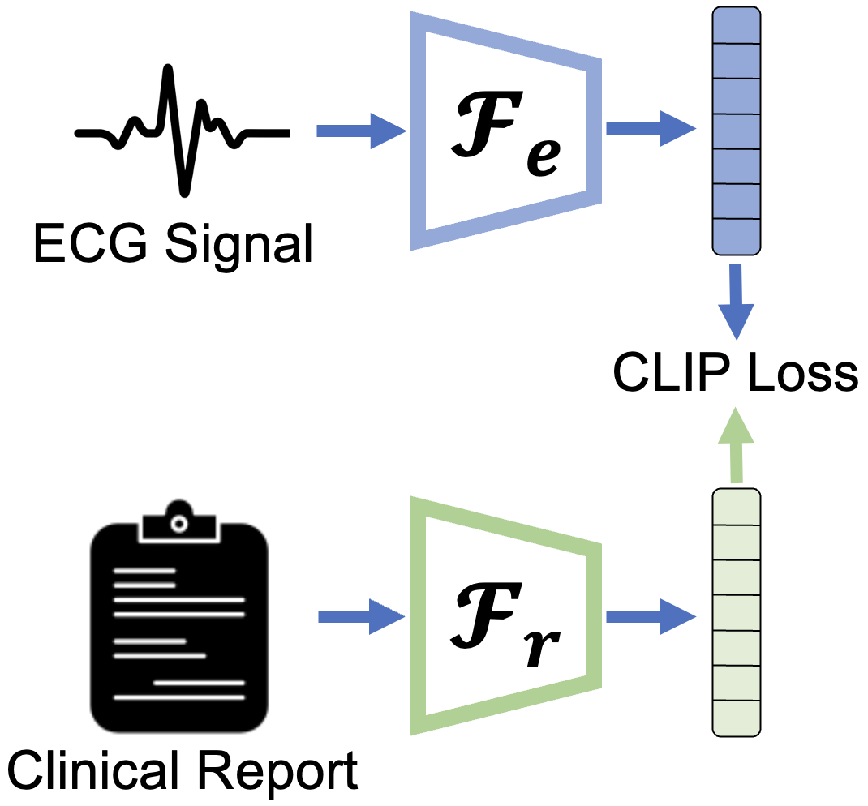
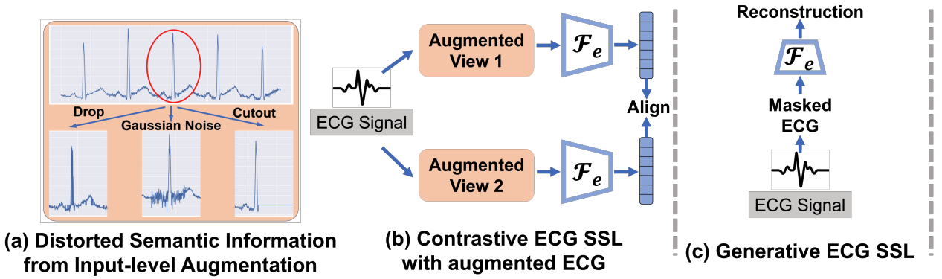
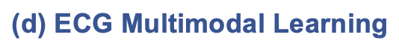
Knowledge-enhanced Multimodal ECG Representation Learning with Arbitrary-Lead Inputs
Motivation of ECG Multimodal Learning

Slide 13
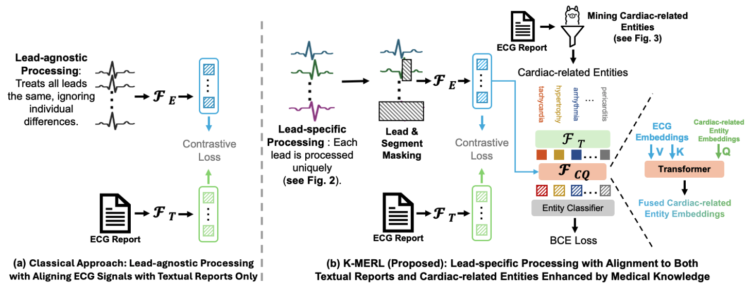
Mining structure knowledge from reports
Lack of Domain Knowledge

Slide 14
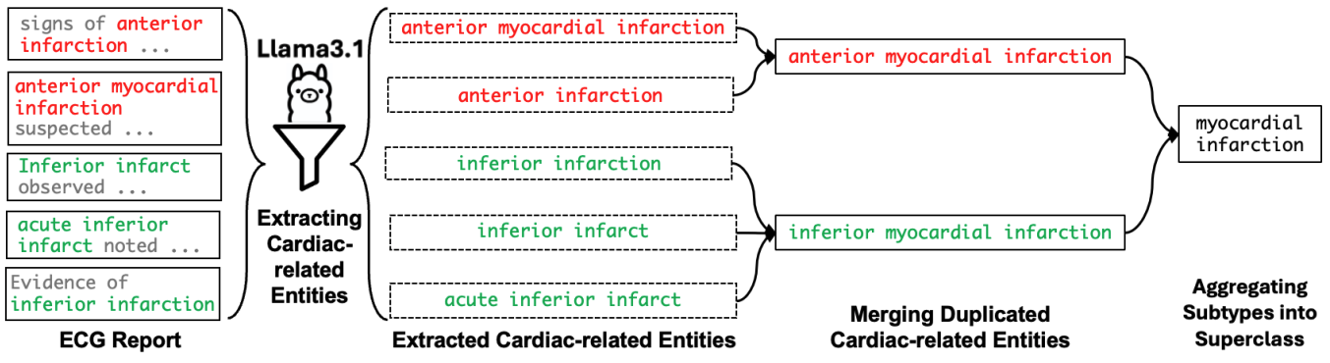
Converting free-text report to structure knowledge via general LLM

Slide 15
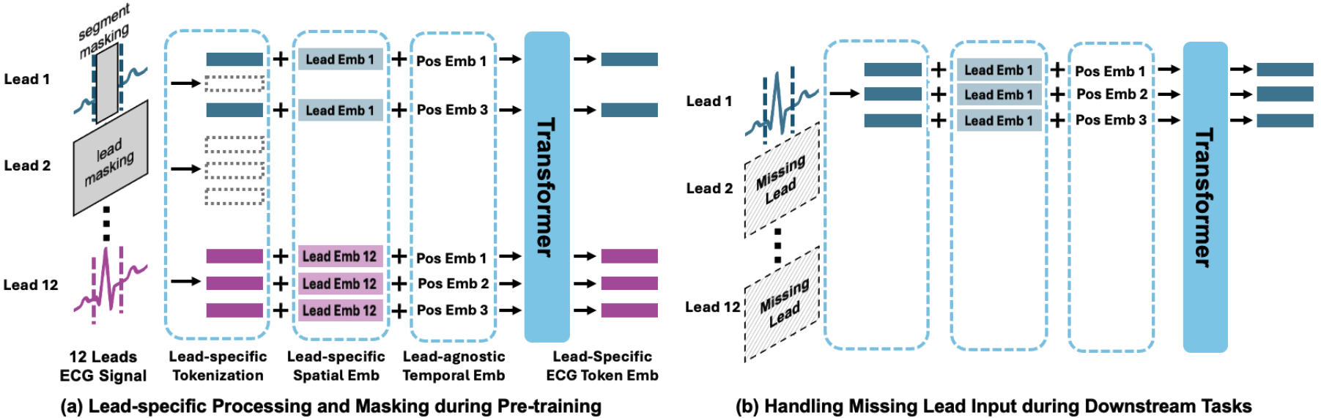
Capture lead-wise pattern and process missing lead

Slide 16
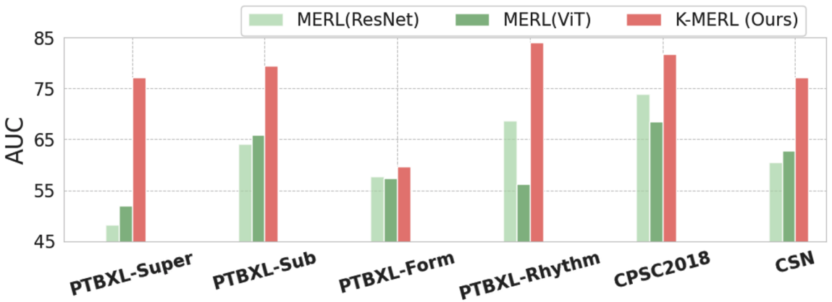
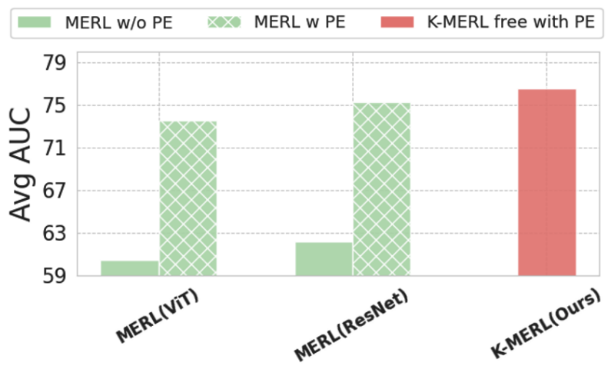
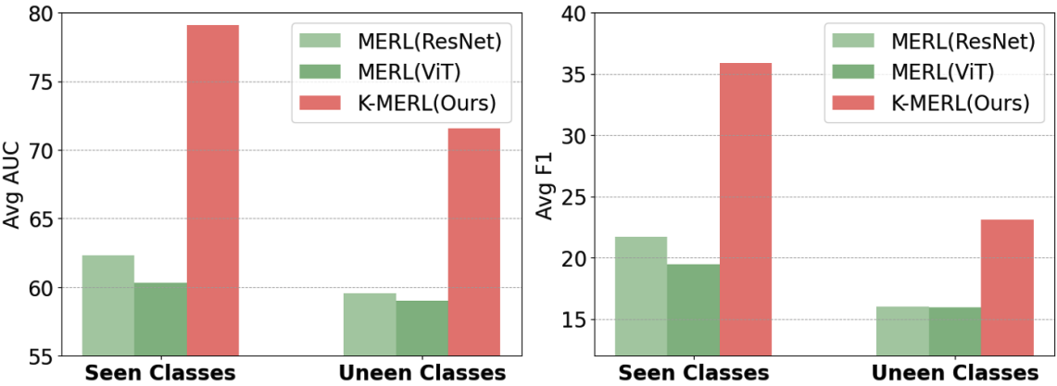
Performance on zero-shot classification across six datasets, comparing K-MERL and MERL (previous SOTA)
Comparison of K-MERL and MERL on seen and unseen classes
Comparison of K-MERL and MERL with prompt engineering (PE).

Slide 17
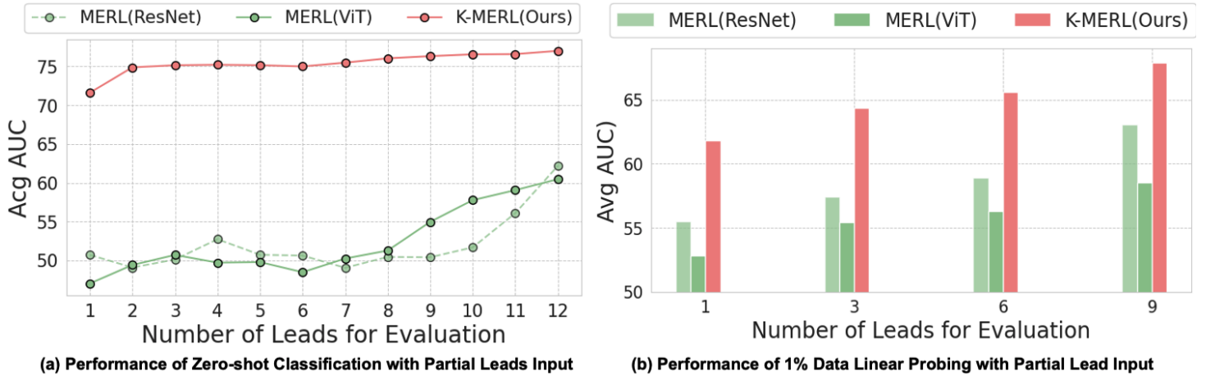
Performance comparison of K-MERL and MERL with partial lead inputs.

Slide 18
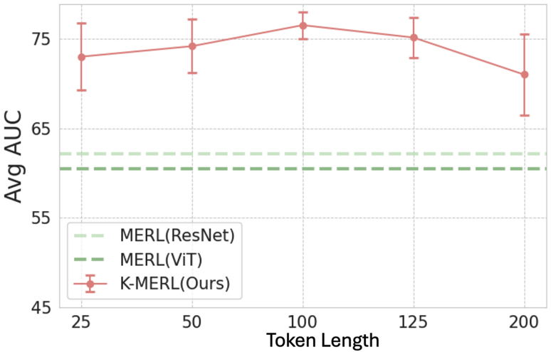
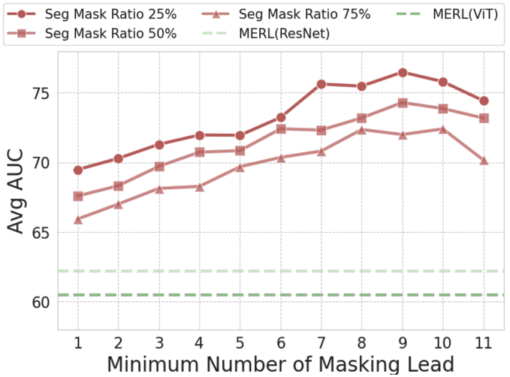
Tokenizer size is matter in transformer-based ECG encoder
Less masked segment + More masked lead provide optimal results

Slide 19
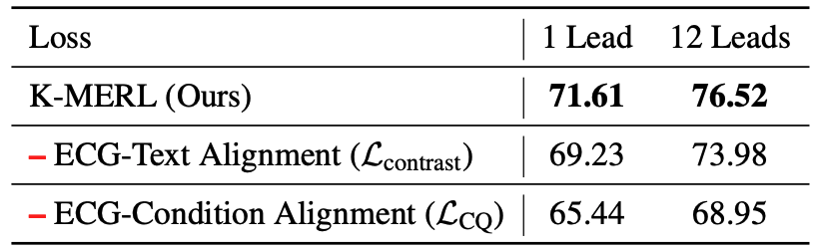
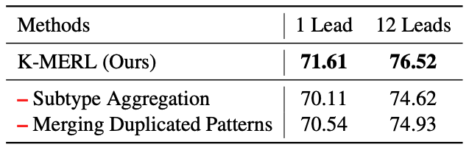
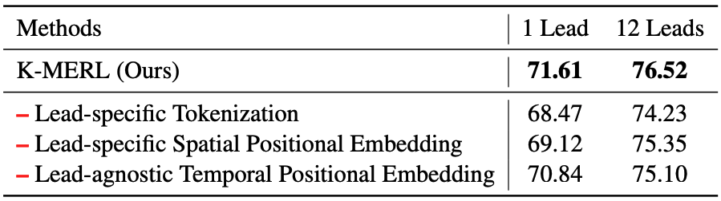
Mined Domain Knowledge is helpful
Mined entities need post-processing
Lead-wise processing is important for ECG

Slide 20
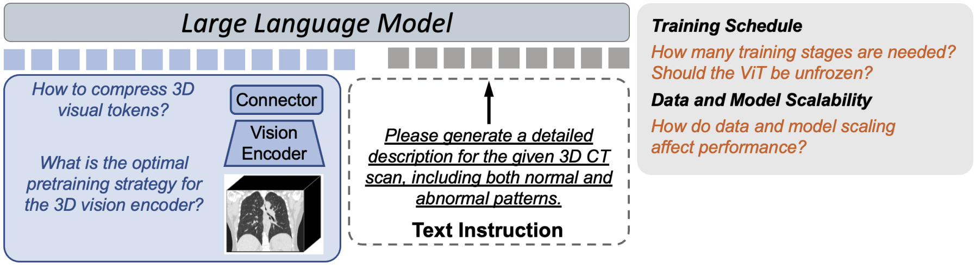
Argus: Benchmarking and Enhancing Vision-Language Models for 3D Radiology Report Generation (3DRRG)

Slide 21
Challenge in 3DRRG:
Small and noisy dataset.
High cost on processing 3D volume.
Lack of metric for 3DRRG

Slide 22
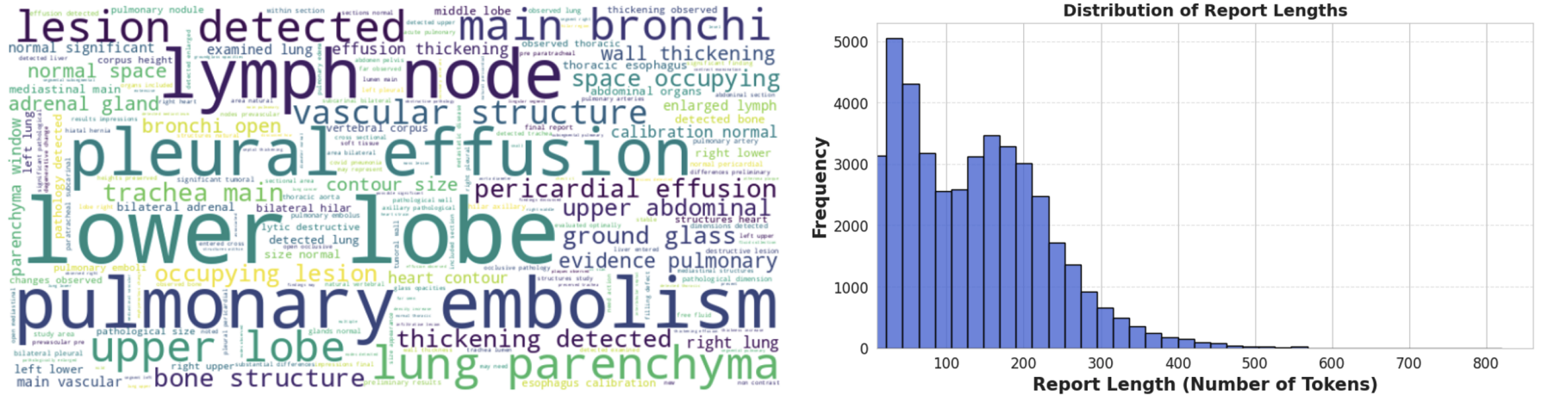
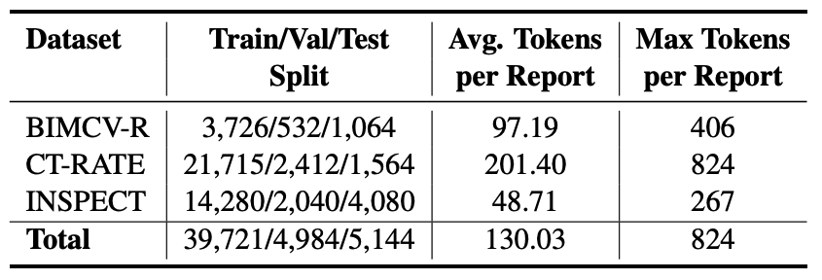
We first build a dataset named CT-3DRRG from public resources.

Slide 23
Clean CT report for 3DRRG
Removal of Numerical Values Not Directly Obtainable from CT Scans:
“SAT O2 without oxygen of 93” and “Fever up 796 to 38”
Removal of Numerical Measurements Dependent on External Tools:
“Increase in trunk caliber of the 39mm pulmonary artery”.
Removal of Sentences Comparing to Previous Studies:
“It is compared to the pre- 811 vious study of March 2019, not mediastinal,”

Slide 24
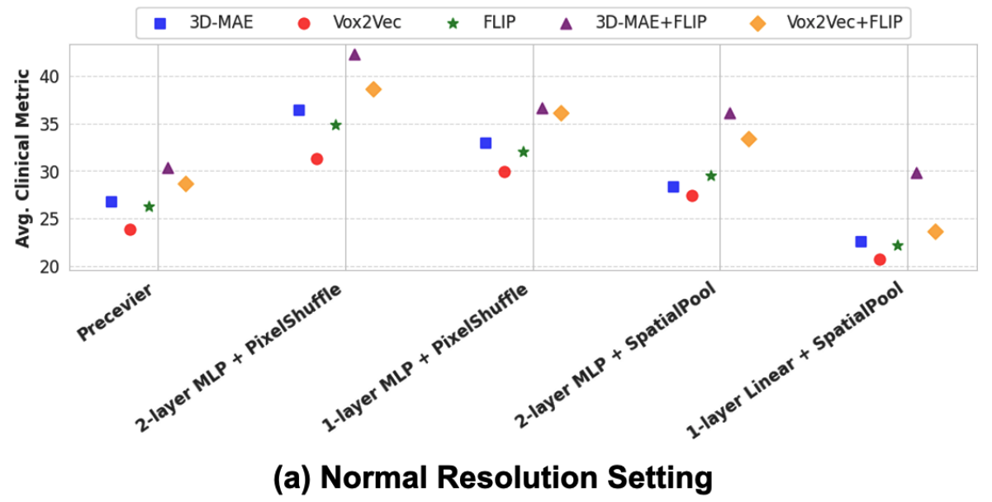
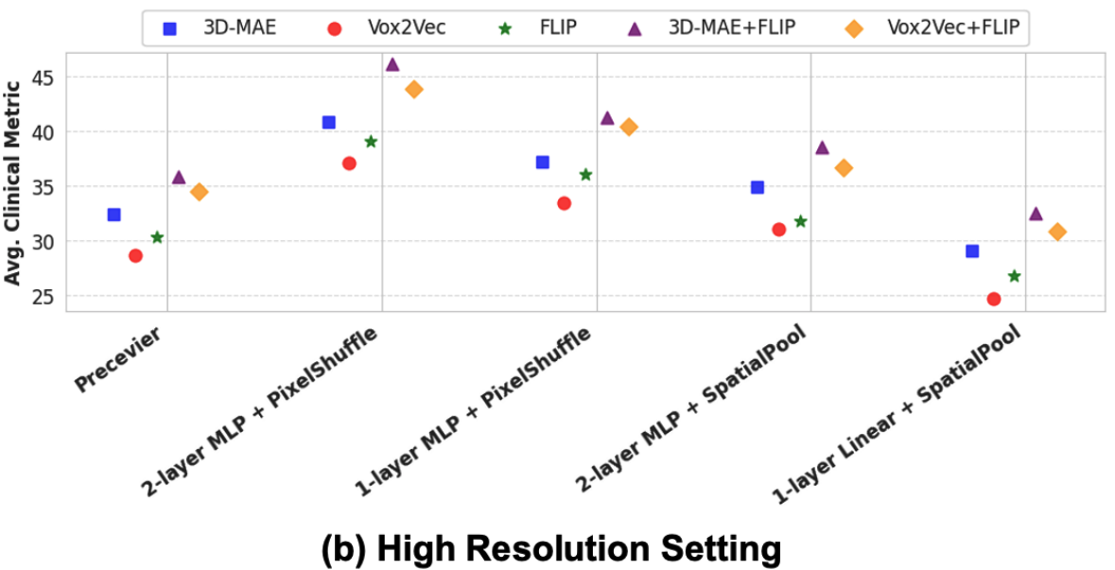
How to prepare vision encoder and connector?
Conclusion:
language supervision is crucial
MAE is better than contrastive learning
Pixel shuffle always better than others, because less information loss.
Higher resolution input provide better results.

Slide 25
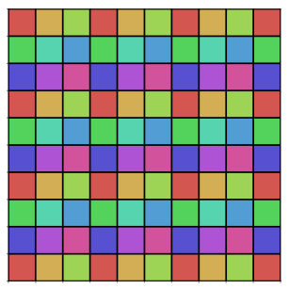
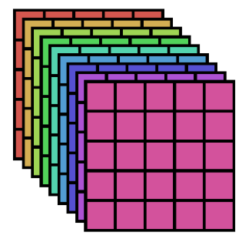
Original Visual Token Map
(d channels)
Downsampled Image
(d*scale^2 channel)
Pixel Shuffle
Scale=3
MLP
H, W, d
(H/scale), (W/scale), (d*scale^2)
All information still existing after pixel shuffle!

Slide 26
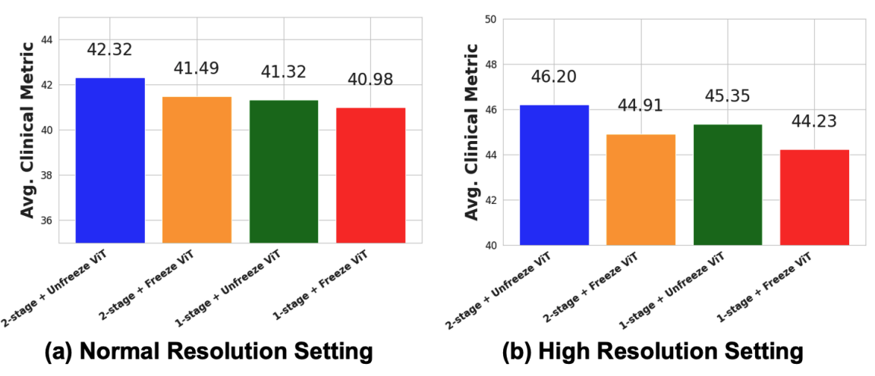
How to train VLM?
More parameters, higher performance!

Slide 27
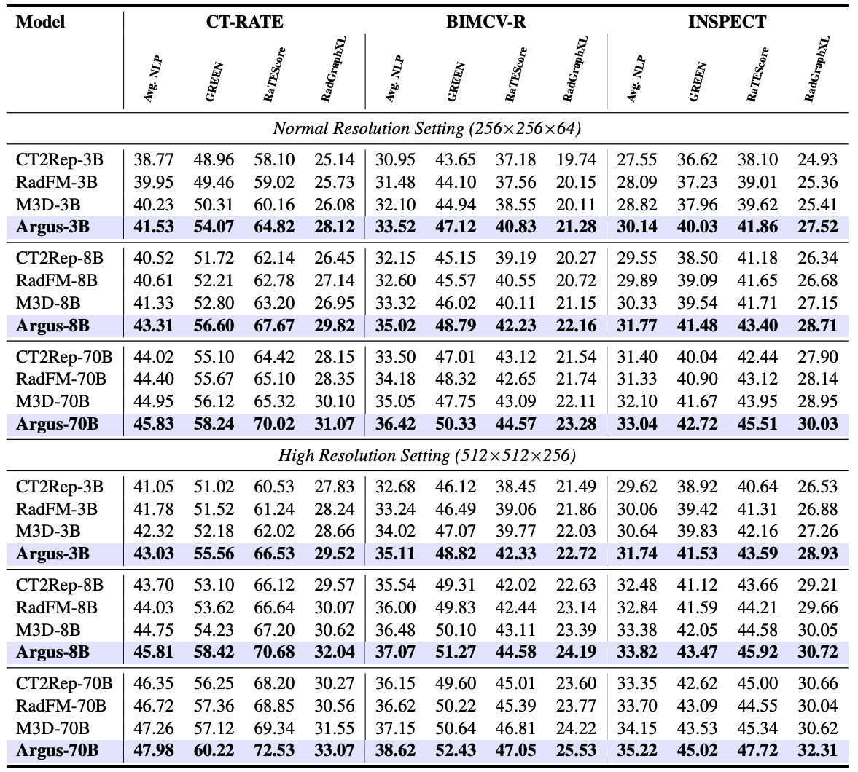
Performance of various scale VLM on 3DRRG tasks.

Slide 28
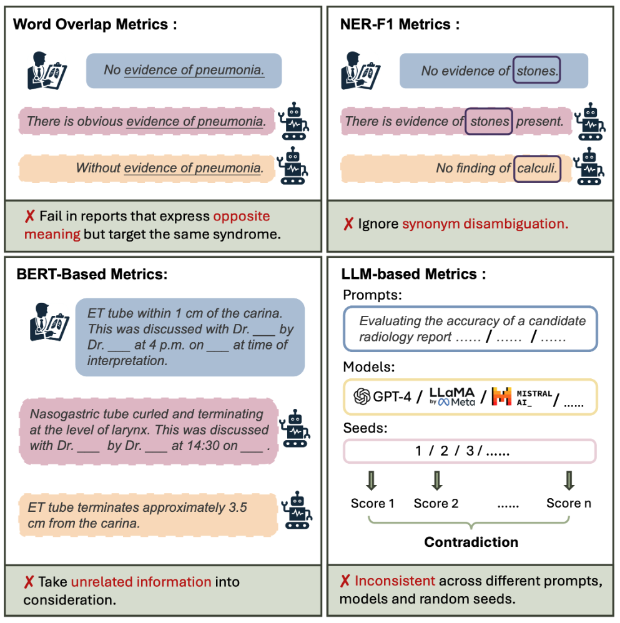
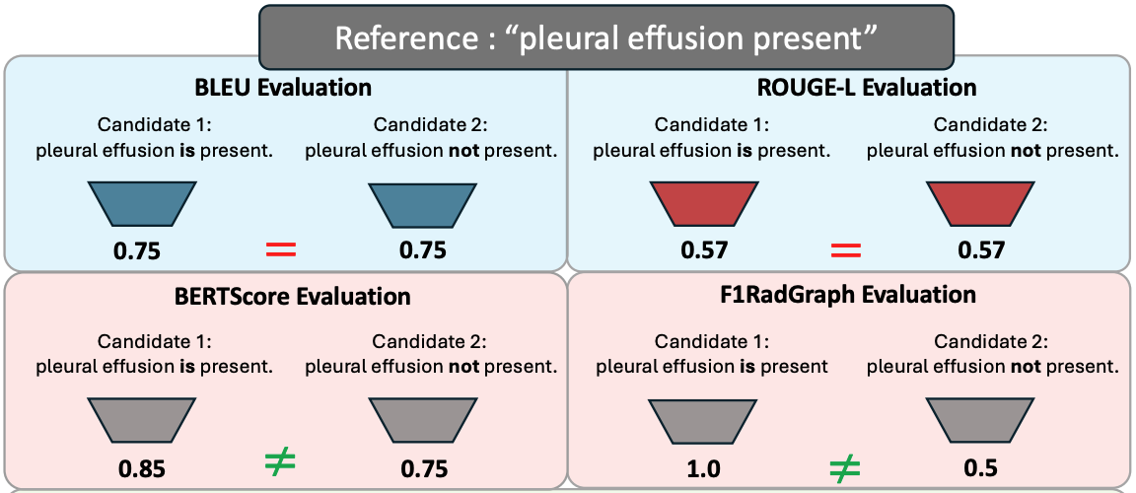
Unsolved Challenge – ambiguous metric in 3DRRG
Can we design a tool, compare radiology report could has more than 150k diagnosis name?

Slide 29
Thanks!

